Slide 1



TRUSTWORTHY GENAI IN HIGHER EDUCATION:
FROM INNOVATION TO COMPLIANCE
Tianmin Zhang
NetSage Consulting Team

Slide 2

THE RESEARCHER’S DILEMMA
A professor wants to use GenAI on sensitive medical data, but fears compliance risks, data misuse, and opaque black boxes.

Slide 3

Problem Statement
Researchers want to leverage Generative AI for sensitive data, but face compliance risks, lack of transparency, and cost uncertainty — preventing adoption.

Slide 4

USER PAIN POINTS
Research requires innovation, but institutions demand compliance.
Lack of observability makes AI adoption risky.
Without trust, universities hesitate to deploy GenAI.

Slide 5
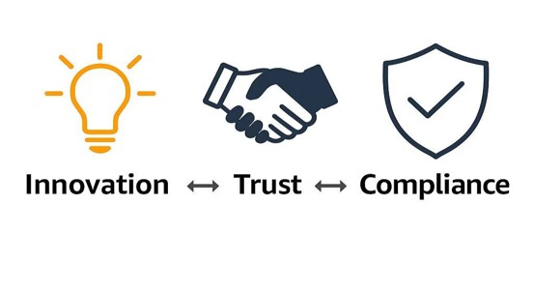

OUR SOLUTION CONCEPT
A secure sandbox where GenAI models can be trained and deployed with full visibility and compliance assurance.
Secure AI sandbox environment
Full transparency & monitoring
Compliance + Innovation together

Slide 6
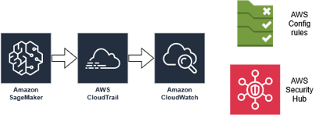
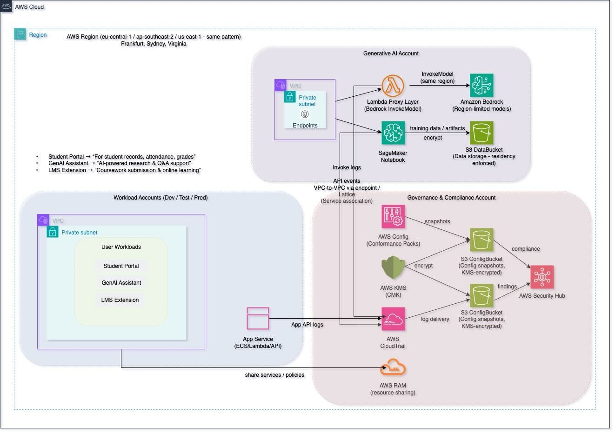
HIGH-LEVEL ARCHITECTURE
From training to audit — every step is traceable
Role separation:
Evidence/enforcement =
CloudTrail + Security Hub + Config;
Operations visibility =
CloudWatch dashboards
(latency, errors, cost/compliance cards).

Slide 7

HOW IT WORKS:
TRAINING
Researcher launches training job
CloudTrail logs “who, when, what”
Traceable from the first step

Slide 8
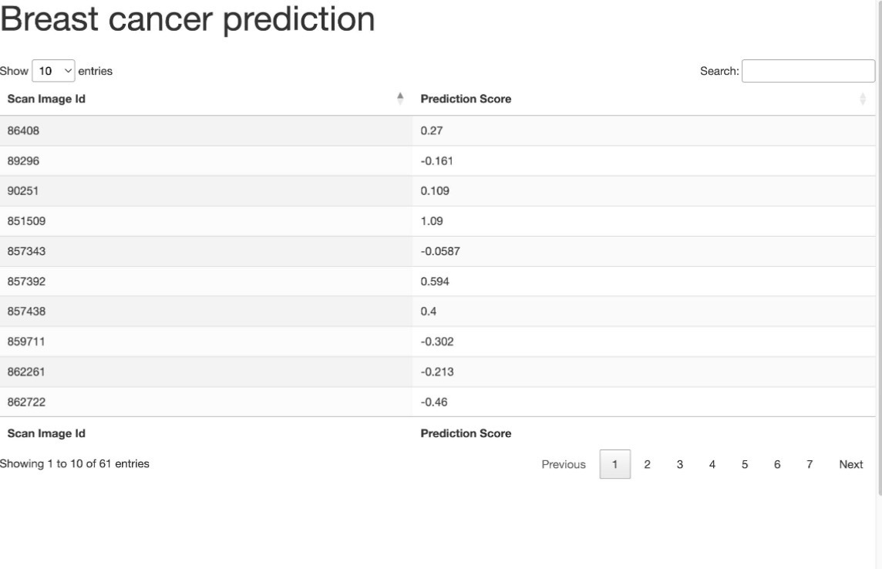
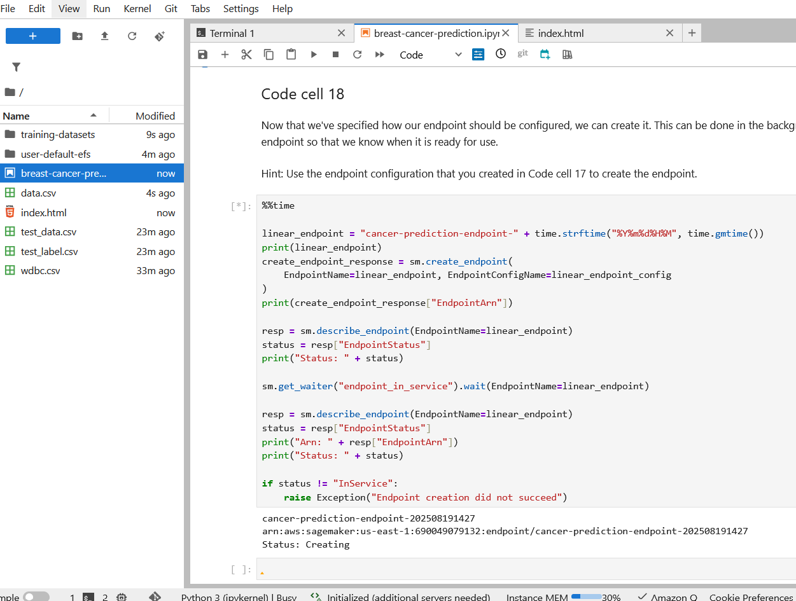
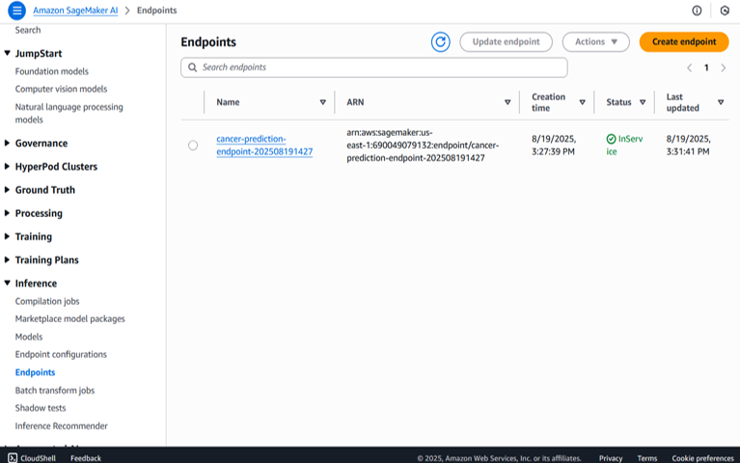
HOW IT WORKS: PREDICTION
Results tied to logs & metadata
Every output is reproducible
Model generates predictions

Slide 9
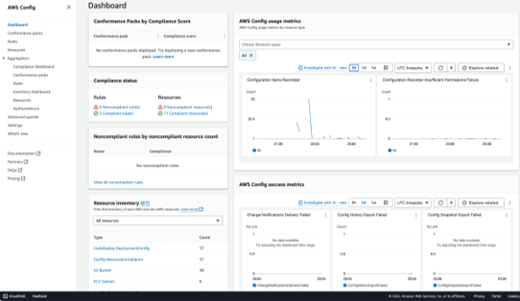
How It Works: Compliance
CloudTrail tracks all activities
Audit trails visible in real time
Transforms AI from black box → glass box

Slide 10

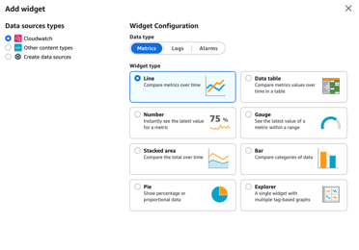
DEMO DASHBOARD VIEW
Real-time observability
Track models, data, users
One view for IT + Compliance

Slide 11
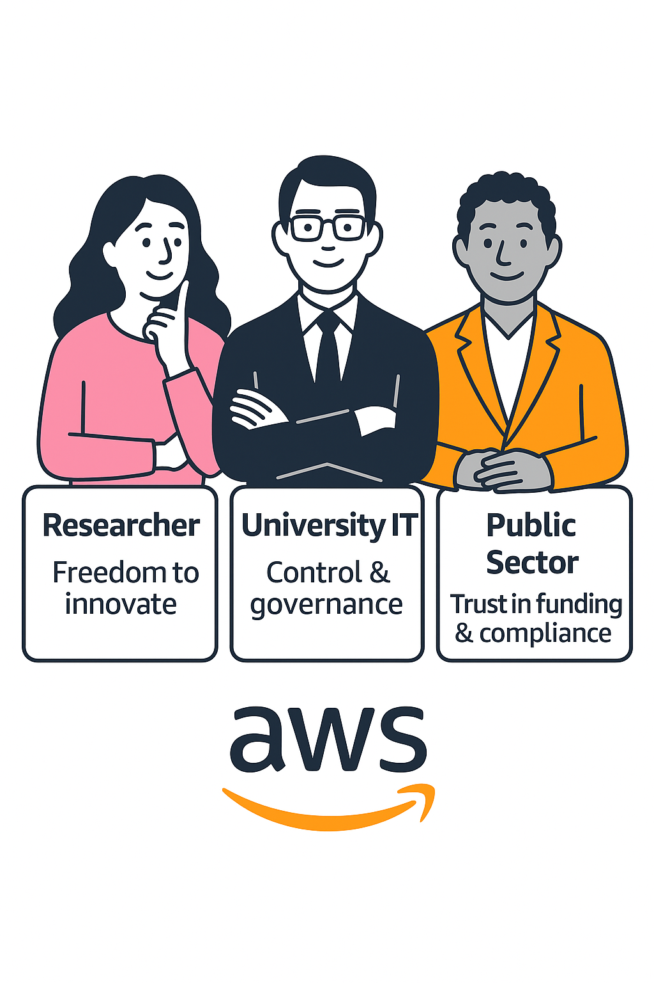
HOW WE HELP
IMPACT FOR STAKEHOLDERS

Slide 12
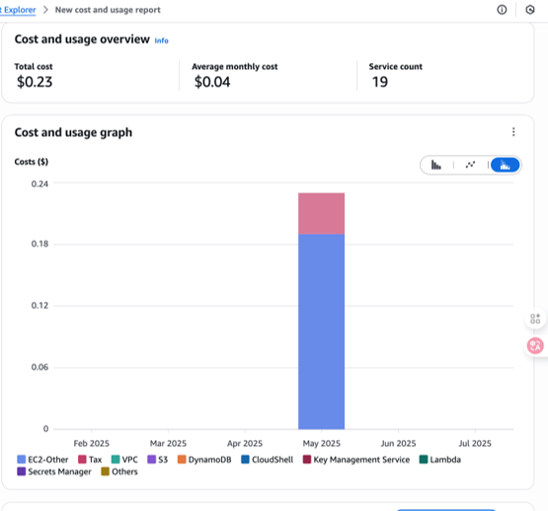
COST & OPTIMIZATION
MVP costs are almost negligible — < $1 total so far.
Serverless (Lambda, API Gateway, Bedrock pay-per-use) ensures “pay only for what you use”.
Cost visibility via AWS Cost Explorer — ready for alerts/budgets as we scale.
Future optimization: reserved capacity, spot instances, multi-tier storage.

Slide 13
“INNOVATION AND COMPLIANCE ARE NO LONGER ENEMIES —
THEY ARE PARTNERS.”
Big message: “Trustworthy AI makes adoption possible.”

Slide 14

Executive Summary
WHY
CHOOSE
US?
Secure & Compliant by Design • Built-in governance with AWS Config, CloudTrail, KMS, and Security Hub. • Meets global data residency & compliance needs (e.g., GDPR, FERPA).
Scalable & Cost-Efficient
• Serverless-first architecture (Lambda, Bedrock, API Gateway) ensures pay-per-use. • Proven MVP running at < $1 cost, with clear path to scale globally.
Future-Ready Innovation
• Seamless integration of Generative AI (Bedrock, SageMaker) into existing LMS. • Provides a foundation for continuous improvement — sandbox today, enterprise tomorrow.

Slide 15
